Slide 1

Updating and fine-tuning UNIDO’s
Integrated Results and Performance Framework
Briefing for the Executive Board
by the Office of Strategic Planning and Coordination
Vienna, 12 December 2017

Slide 2
Strengthening UNIDO’s results orientation
Rationale:
    Member States (GC) and Donor community (bilateral, GEF, etc.)
    2030 Agenda: greater impact required to achieve ambitious interlinked agenda
    UNDS reform: clearer results and performance reporting for longer-term positioning of UNIDO within the UNDS
    Internal efficiency and effectiveness gains: supporting our TC delivery with concrete results
    Communication benefits: better tell UNIDO’s performance story
    JIU: respond to 2016 report on UNIDO management, 2017 report on RBM
    Largely insufficient results monitoring and reporting mechanisms in UNIDO
  Better understand our results chain to further improve our work

Slide 3

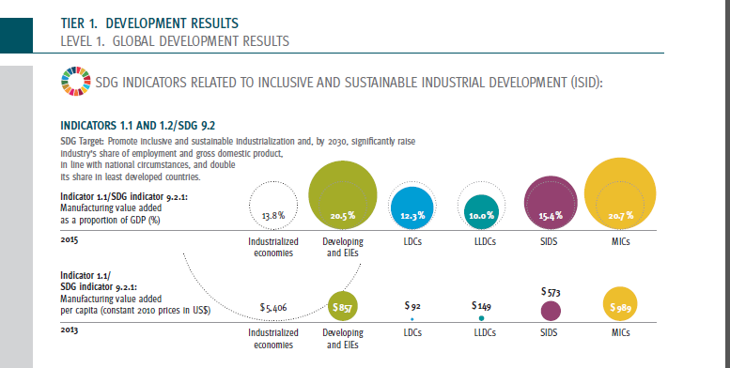
Starting point: UNIDO’s Corporate Scorecard
UNIDO reports on IRPF indicators in a Corporate Scorecard
Scorecard published in Annual Report 2016 and on Open Data Platform
But considerable gaps and outdated model

Slide 4
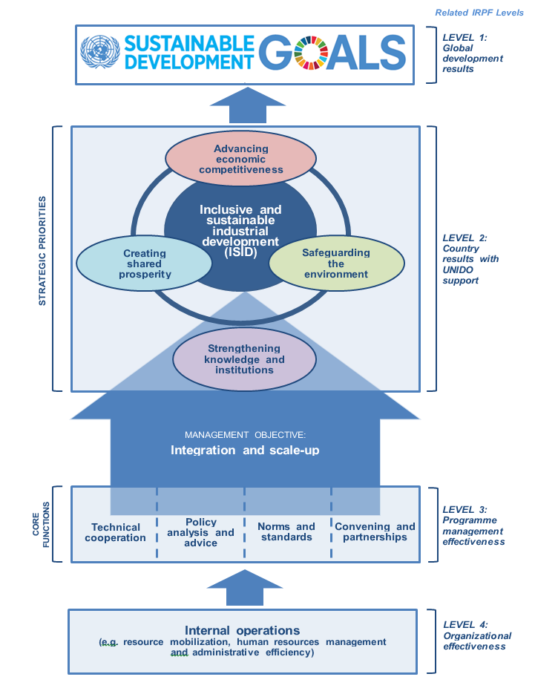
What changes now?
New MTPF 2018-2021
  aims to move from a project-based to a more programmatic/country approach
  prioritizes integration of TC, policy, normative and convening functions
  fits in fourth strategic priority as an enabler for ISID
  logically linking each IRPF level
  explaining UNIDO’s (simplified) Theory of Change of our contribution to inclusive and sustainable industrial development

Slide 5
Updating and fine-tuning IRPF
Current indicators show a lot of low level results (processes, outputs, country coverage) and very high-level ones (SDGs,...)
The story of “how to get there” is missing: what behavioral changes are taking place thanks to UNIDO’s work?
Explain the big arrow in the MTPF “rocket”!
Results framework - a guide to show UNIDO’s performance. It tells MS, donors, international organizations, and other stakeholders how good and effective UNIDO is and why it is doing what it is doing. Getting the results right is of paramount importance
IRPF indicators need to be adapted to reflect new MTPF
Indicators (incl. baselines and targets) need to be improved and monitored

Slide 6
RBM principles
But before getting to the indicators...
JIU Report on RBM 2017 defines the following key principles of RBM:
  Vision and clarity of desired end product or impact
  Causal linkage in a hierarchy of results (inputs, activities, outputs, outcomes, impact) based on theory of how change happens
  System-operation that goes beyond linear logic and considers context, espouses equifinality, and addresses risks and conditions for success for achieving higher-level results
  Performance measurement for transparency, consensus building, and having a common perspective on results, as well as for accountability
  Performance monitoring for single loop learning, and evaluation for double-loop learning

Slide 7
A one-UNIDO approach
UNIDO’s results chain logic needs to be revised to improve our understanding and ability to measure and report
External senior consultant hired to help us in the process
Consultations have been taking place within UNIDO and wide-spread support has been reached for a new results chain logic: all MDs/DDG, PTC/PRM, PRS, ENE, ENV, PCP teams, Gender office etc.
Excellent cooperation so far
Introducing and mainstreaming one common results chain framework: Bennett hierarchy, spheres of control/influence
Use of representative “stories” to mainstream framework: Energy management systems, PCPs, gender, standards and policy advice (cross-department), ENV, etc.
Slowly introducing Theory of Change approach: accounting for complexity - partners, time, risks and assumptions

Slide 8




Mainstreaming a common framework:
Basic Results Chain With Key Questions
Program (Results) Chain of Events
(Theory of Action)
Key Questions
Indirect Influence
7. End results
7. What is our impact on ‘ends’?
WHY?
6. Practice and behavior change
6. Do we influence [behavioural] change?
5. Knowledge, attitude, skill and / or aspirations changes
5. What do people learn? Do we address their needs?
WHAT?
Direct Influence
4. Reactions
4. Are clients satisfied? How do people learn about us?
WHO?
3. Engagement / involvement
3. Who do we reach? Who uses / participates?
Control
2. Activities and outputs
2. What do we offer? How do we deliver?
HOW?
1. Inputs
1. How much does our program cost? ($, HR etc)
Source: Adapted for UNIDO by Steve Montague from Claude Bennett 1979. Taken from Michael Quinn Patton, Utilization-Focused Evaluation: The New Century Text, Thousand Oaks, California, 1997, p 235.

Slide 9
A dual approach to IRPF
Indicators: Update and fine-tune indicators framework to reflect “integration and scale up”, “strengthening knowledge and institutions” and improve current indicators - but problems of aggregation due to UNIDO’s variety of intervention areas.
Narratives: performance “stories”/ case studies to complement the indicators framework, help explain the arrow and illustrate how UNIDO provides an integrated contribution over time to ISID
In addition: proposed research to better explain the arrow between IRPF levels 2 and 1: ISID contribution to SDGs can be explained by INTERLINKAGES between SDGs and targets. Generative learning will help UNIDO to constantly improve
Complementary to PTC work on project level financial data

Slide 10

Timeline
Continue revising and fine-tuning IRPF in Task Force with a focus on:
  better telling the “UNIDO story” by supplementing quantitative indicators with a qualitative narrative
  improving development results monitoring processes and products
Further work on ToC mainstreaming, results monitoring and reporting
Study/ research on SDGs interlinkages
Communicate to MS on new IRPF, baselines and targets at PBC.34
Consultations and workshops (?) to UNIDO staff in PTC and other departments to train them on using the new results framework (for use in PCPs, etc.)

Slide 11
Thank you!

